Slide 1
The Fearless Organization
Amanda Clay Powers
Dana Development Day
August 22, 2025

Slide 2
REMINDER: Ground Rules
Be kind
Be curious
No playing devil’s advocate
Focus on learning, not debating
Think of your intentions and impact
Listen and acknowledge each other
Step forward, step back
No personal attacks

Slide 3
BECOMING FEARLESS

Slide 4

The Plan
Learn how psychological safety allows workplaces to become fearless
Identify teams with and without psychological safety
Develop a plan for creating a fearless organization at Dana

Slide 5
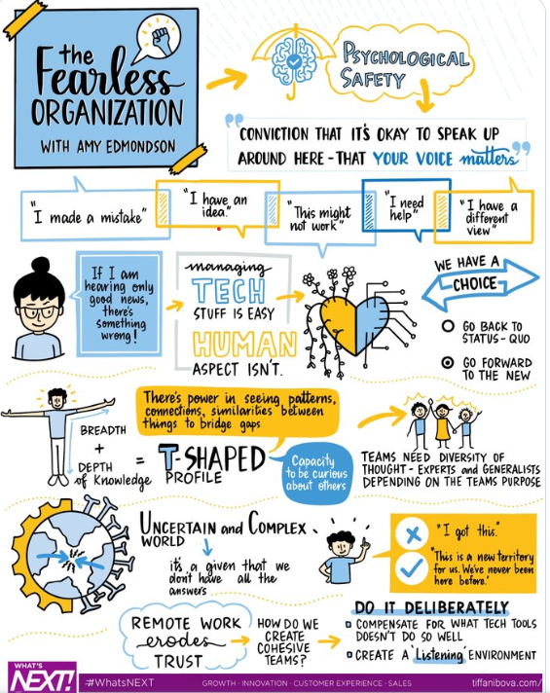
WHAT IS PSYCHOLOGICAL SAFETY?
Mutual respect and interpersonal trust built on a shared belief that the team is a safe place for:
  Seeking feedback
  Sharing information
  Asking for help
  Talking about mistakes
  Experimenting
Notes:
Emerges from Organizational Learning Research, particularly Dr. Amy Edmondson’s “Psychological Safety and Learning Behavior in Work Teams,” in the late 1990s. Mature theory at this point, moving from organizational behavior theory to other disciplines. Reframe failures as an opportunity to learn.

Slide 6
WHAT IS THE ESSENCE OF PSYCHOLOGICAL SAFETY AT WORK?
“a belief that one will not be punished or humiliated for speaking up with ideas, questions, concerns, or mistakes, and that the team is safe for interpersonal risk taking”
– Amy Edmondson

Slide 7

What is not psychological safety?
RESILIENCE

Slide 8
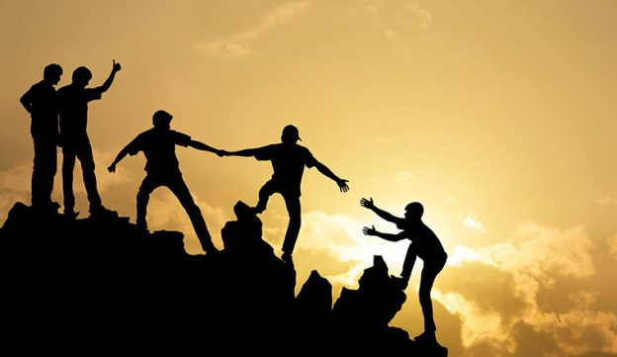
What is?

Slide 9
What can go wrong?

Slide 10

TEAMS THAT STAGNATE
Hold onto the past
Share only jointly held information
Fear asking for help
Will not engage in problem-solving
Will shut down curiosity when facing the potential for threat or embarrassment
Vulnerable to “groupthink”

Slide 11
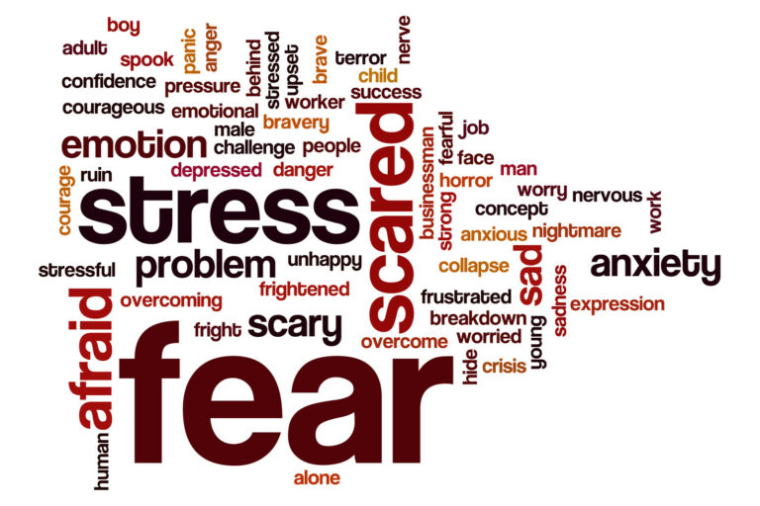

Slide 12
WHAT ARE UNHELPFUL QUALITIES OF A TEAM YOU’VE BEEN ON?
What does your gut tell you when your team isn’t working out?
How does it feel to share your ideas?
What will happen if you make a mistake or fail?

Slide 13
INDICATIONS A TEAM IS IN TROUBLE
High turnover or continually “on leave”
Signs of micromanaging
Silence in meetings or continually in agreement with management
Decisions get escalated to top levels
Characterized by burnout and hopelessness

Slide 14
What if it goes right?

Slide 15
TEAMS THAT THRIVE
Admit mistakes, discuss problems, and ask for help without fear
Disagree and challenge other’s views safely
Believe that the team will assume good intentions
Believe that they are empowered to influence and create change
Acquire, share, and combine knowledge​
Discuss ideas, are creative, and explore new avenues for solutions​
Notes:
Believes that the team will not embarrass, reject, or punish someone for speaking up / feels heard. They will communicate candidly in a timely fashion.

Slide 16
WHAT’S THE BEST TEAM YOU’VE BEEN ON?

Slide 17
QUESTIONS TO CONSIDER
What was the general feeling in meetings?
What did you enjoy about working on the team?
What happened when there were problems or conflicts?

Slide 18
INDICATIONS A TEAM IS SAFE
Speak roughly in the same proportions
Feel relaxed and energized in meetings
Believe other team members are reliable
Are willing to have hard or “messy” conversations
Feel heard and appreciated
Generate creative solutions

Slide 19
WHAT ARE THE ATTRIBUTES HEALTHY TEAMS HAVE IN COMMON?

Slide 20
QUESTIONS TO CONSIDER
What do you need from others on a team to feel safe?
What do you think your teammates need from you?
What is lacking on a team that struggles?

Slide 21
TRUST
Characterized by mutual respect
Willing to be vulnerable
Care about each other as people
Not afraid they will be rejected
We become incubators of creativity and innovation
AS A CONSEQUENCE:

Slide 22
DEI / IDEA AND
PSYCHOLOGICAL SAFETY

Slide 23
DEI (IDEA) AND PSYCHOLOGICAL SAFETY
Diverse teams with low psychological safety are less productive than homogenous teams
  Face communication challenges
  Lack commonly held beliefs

Slide 24
DEI (IDEA) AND PSYCHOLOGICAL SAFETY
Diverse teams with high psychological security outperform homogeneous teams
  Implicit bias and microaggressions
  Effective apologies
  Essential to achieving breakthroughs
  Experiment, grow, and foster excellence

Slide 25
HOW DO WE GET STARTED?

Slide 26

GETTING STARTED: SUPPORT
Adequate resources
Transparent decisions
Reward risk-taking
Opportunities for growth
Removing obstacles
Set clear expectations
Notes:
Helps steady organizations against internal and external pressures that threaten performance. Better leverage diversity. Reduces turnover

Slide 27

GETTING STARTED: LEADERS
Establish clear goals and mission
Model non-defensive responses
Demonstrate risk taking
Practice curiosity and asking questions

Slide 28

GETTING STARTED: TEAM MEMBERS
Clarify goals and objectives
Share small personal things to build trust
Create a “safe” brainstorming environment
Use Ground Rules for sharing and discussion
Ask questions and withhold judgement
This Photo by Unknown Author is licensed under CC BY-SA

Slide 29
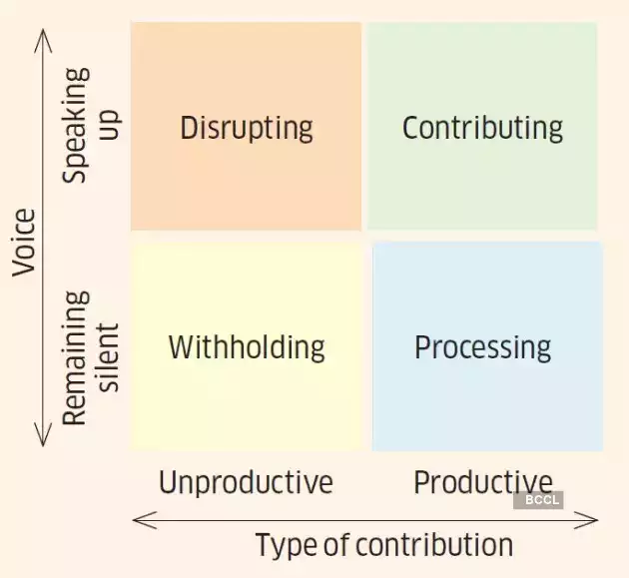

Slide 30
WHAT DOES THIS LOOK LIKE FOR YOU?

Slide 31
QUESTIONS TO CONSIDER
What are the positives of risk-taking?
What are the challenges?
What can you do to make your team safer for innovating and risk-taking?
How can you implement the Step Up and Step Back method on your team?

Slide 32
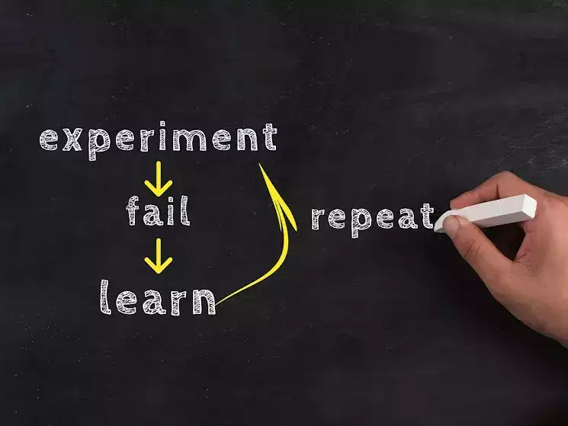
PSYCHOLOGICALLY SAFE TEAMS
Foster team members’ confidence
Believe that the team is capable of using new information to generate useful results
Value curiosity and experimentation
Believe that failure is a powerful tool for learning

Slide 33
WHAT COMES NEXT FOR US?

Slide 34
WHAT HAPPENS NEXT?
True
False
Decisions are better
Consensus is possible
Sharing is easier
Benefit of the doubt is a priority
Debate is considered healthy
Innovation is pursued and rewarded
All ideas are implemented
Disagreements are easy to resolve
Conflict is a thing of the past
Everyone wins every time
Standards are lower
Everyone is nice all the time

Slide 35
Thoughts? Questions? Ideas?

Slide 36
Citations
Aylesworth, A., & Cleary, R. (2020). Reawakening creativity for business leaders: Removing obstacles. Journal of Education for Business, 95(4), 248–254.
Baker, S.D., Saifuddin, S.M., & Stites, S-D. (2018) Mending the gaps: An exercise in identifying and understanding diverse and multicultural team faultlines. Organization Management Journal, 15:3, 130-143,
Besara, R. & Renaine, J. (2018). Building a culture of strategic risk-taking in a science library: Creating psychological safety and embracing failure. Journal of New Librarianship, 3:1, 3410.
Bresman, H. and Edmondson, A. C. (2022) To excel, diverse teams need psychological safety. Harvard Business Review, March 17.
Duhigg, C. 2016. What Google learned from its quest to build the perfect team. The New York Times Magazine, February 25. https://www.nytimes.com/2016/02/28/magazine/what-google-learned-from-its-quest-to-build-the-perfect-team.html
Edmondson, A. (1999). Psychological safety and learning behavior in work teams. Administrative Science Quarterly, 44:2, 350-383.
Edmondson, A. & Bransby, D. P. (2023). Psychological safety comes of age: Observed themes in an established literature. Annual Review of Organizational Psychology and Organizational Behavior, 10:1, 55-78.
Edmondson, A. & Mortenson, M. (2021). What Psychological Safety Looks Like in a Hybrid Workplace. Harvard Business Review, https://hbr.org/2021/04/what-psychological-safety-looks-like-in-a-hybrid-workplace
Julian, R., & Grove, K. (2020). Building a culture of strategic risk-taking in a science library: Turning failure into learning opportunities . Journal of New Librarianship, 3(1), 53–57.
Lanford, M., & Tierney, W. G. (2022). Creating a culture of mindful innovation in Higher Education. SUNY Press.
McCausland, T. (2023) Creating psychological safety in the workplace. Research-Technology Management, 66:2, 56-58.
Moore, D., & Price, E. (2020). Failing forward. Journal of New Librarianship, 3(1), 16–23.
Nyo, I. (2022) 10 signs that psychological safety is missing in your team. Medium, October 24. https://betterhumans.pub/10-signs-that-psychological-safety-is-missing-in-your-team-e6dbdcf95a9b

